Slide 1

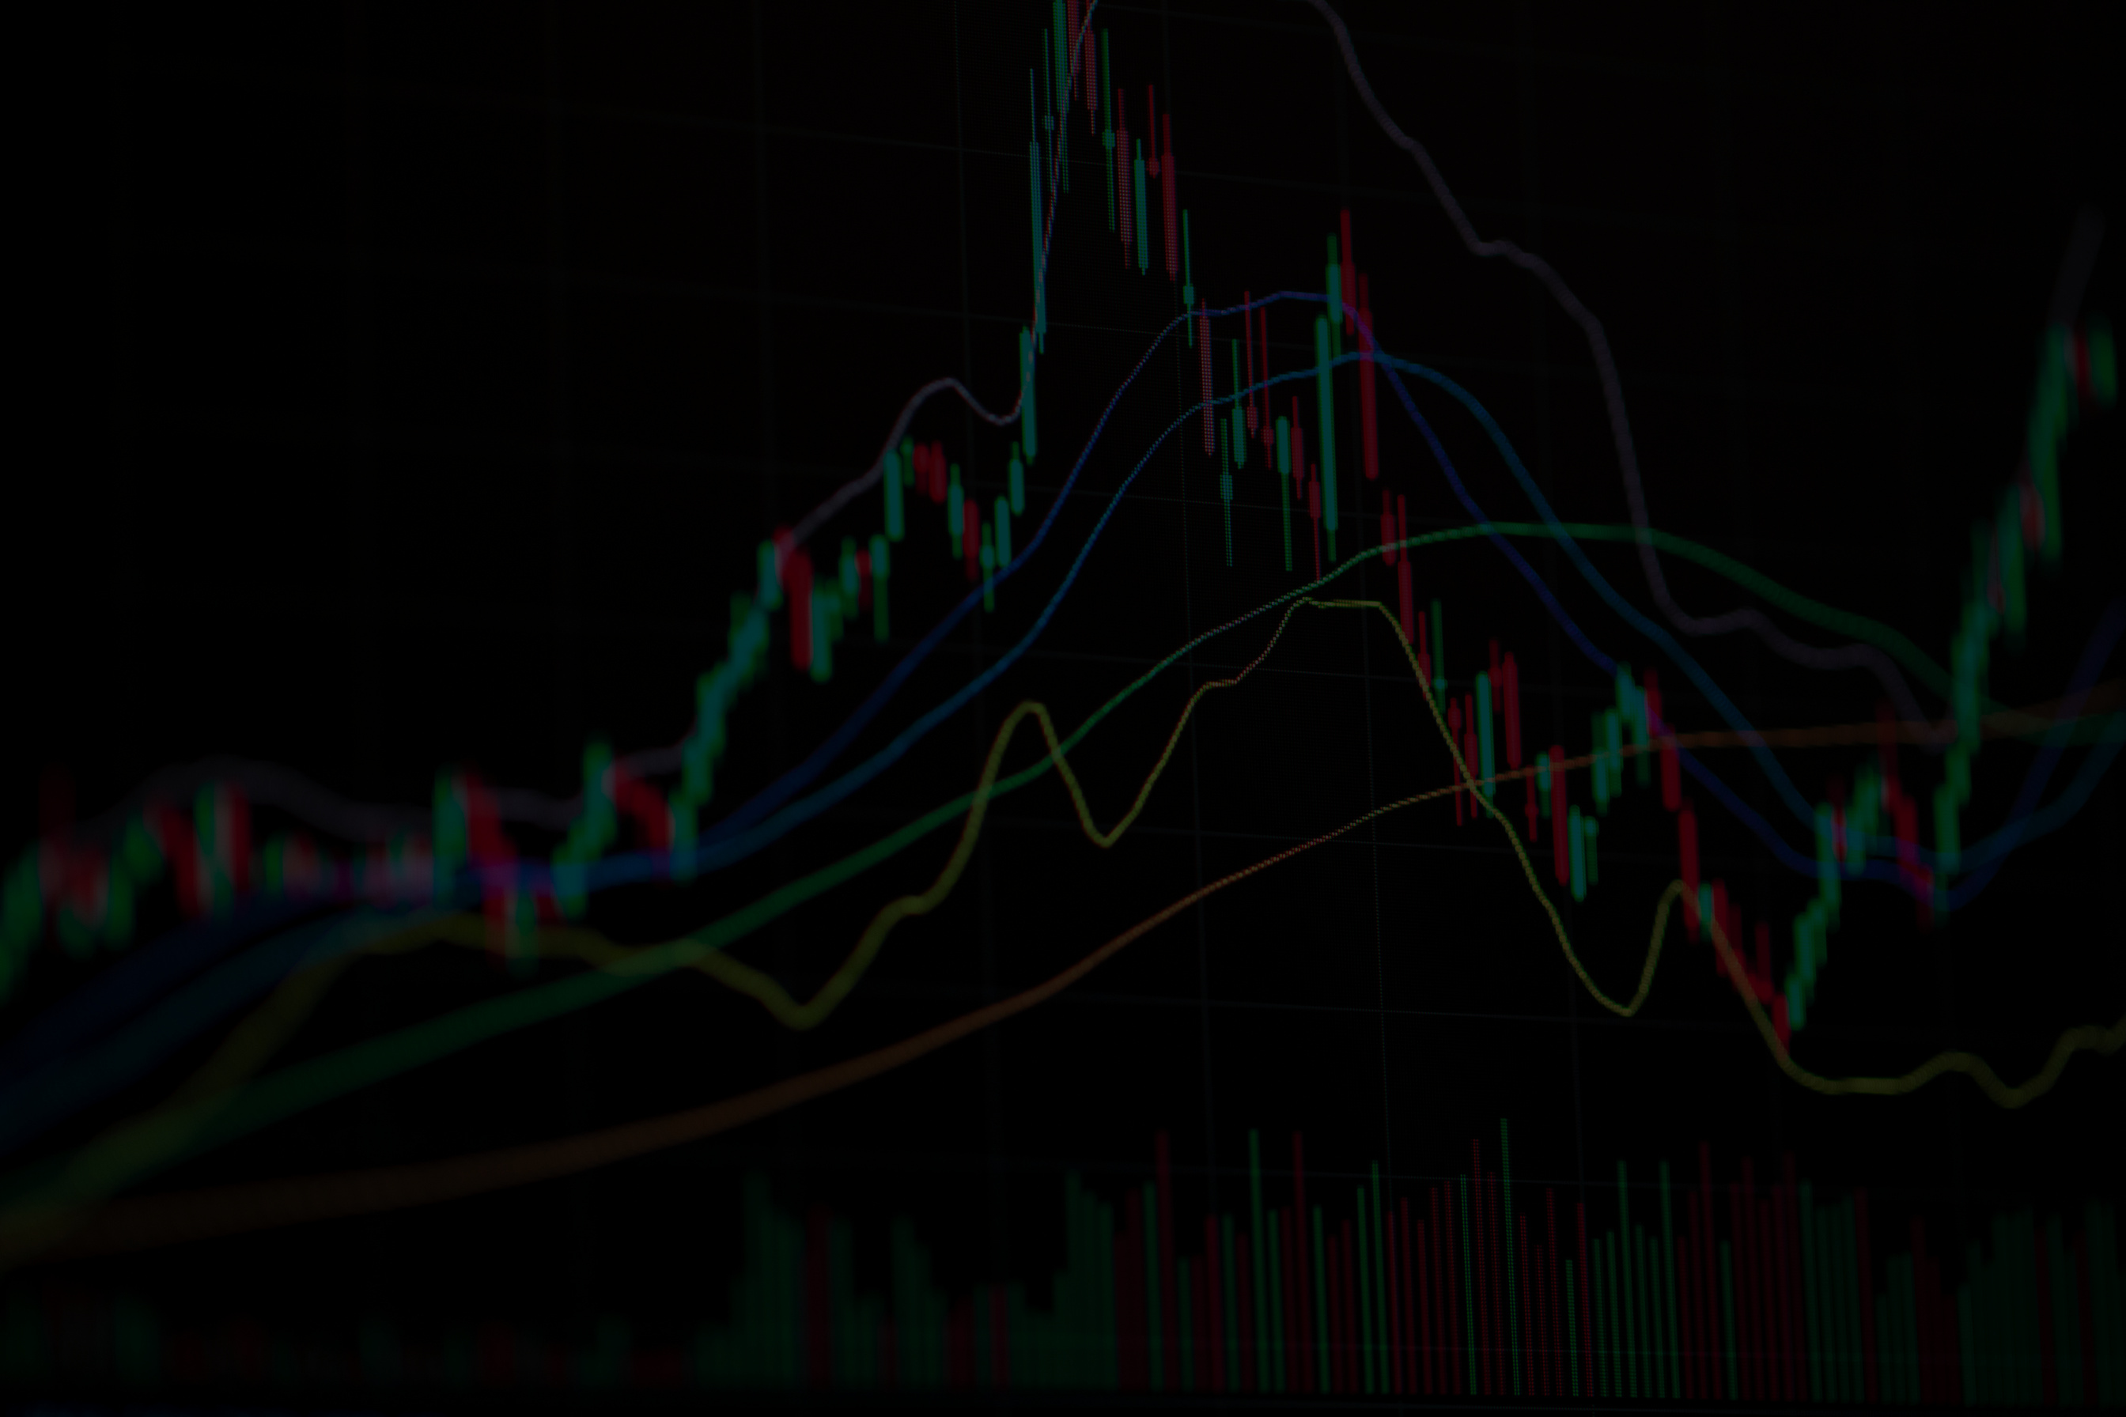

DATA DIGGERS
NIKO PERICA, VICE PERICA, MATE PAPAK, FILIP ALEKSIC

Slide 2

Initial
idea
Compare market option prices with fair prices derived from the Black-Scholes model
Use option prices offered by bots as input and solve the inverse Black-Scholes problem to extract implied volatility

Slide 3
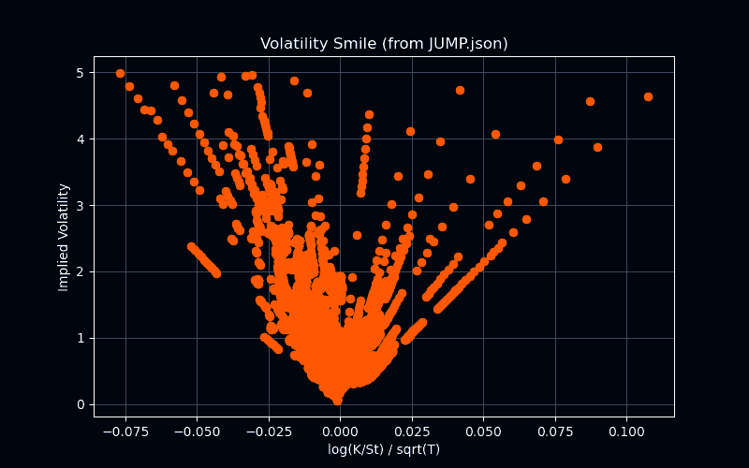

Slide 4
Refined Insight
& Updated Ideas
Closer inspection of the options market revealed clear profitable opportunities
Bots frequently offer prices significantly below or above any logical fair value
New goal: develop a simple, fast, and effective model to exploit these inefficiencies
Focus on practical implementation over theoretical complexity
Prioritize speed and simplicity to react in real time to mispriced options

Slide 5
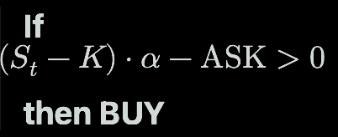
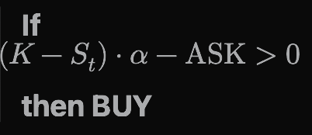
ROUND 1
St
CURRENT PRICE
CALL:
K
STRIKE PRICE
PUT:
ALPHA
PARAMETER

Slide 6
ROUND 2
If it ain't broken, don't fix it.
In this round, we decided to first apply our buying conditions to options with shorter maturities in order to get the money back faster

Slide 7
ROUND 3
In this round we prioritized SPEED
We removed the improvment from the last round (speed is key)
We explored the best alpha -> (0.85-0.95)
If we buy it, they can’t.

Slide 8
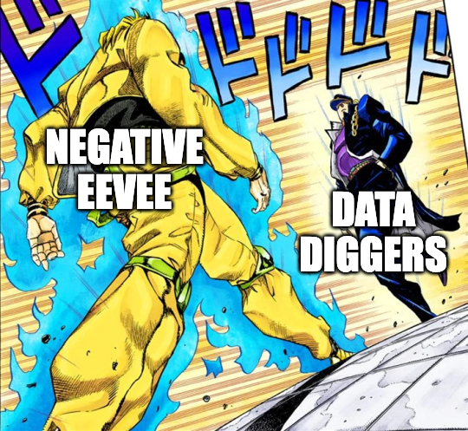
ROUND 4:

Slide 9
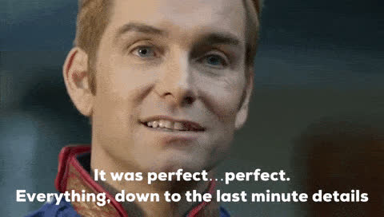
ROUND 5: NO CHANGE TO THE BOT

Slide 10
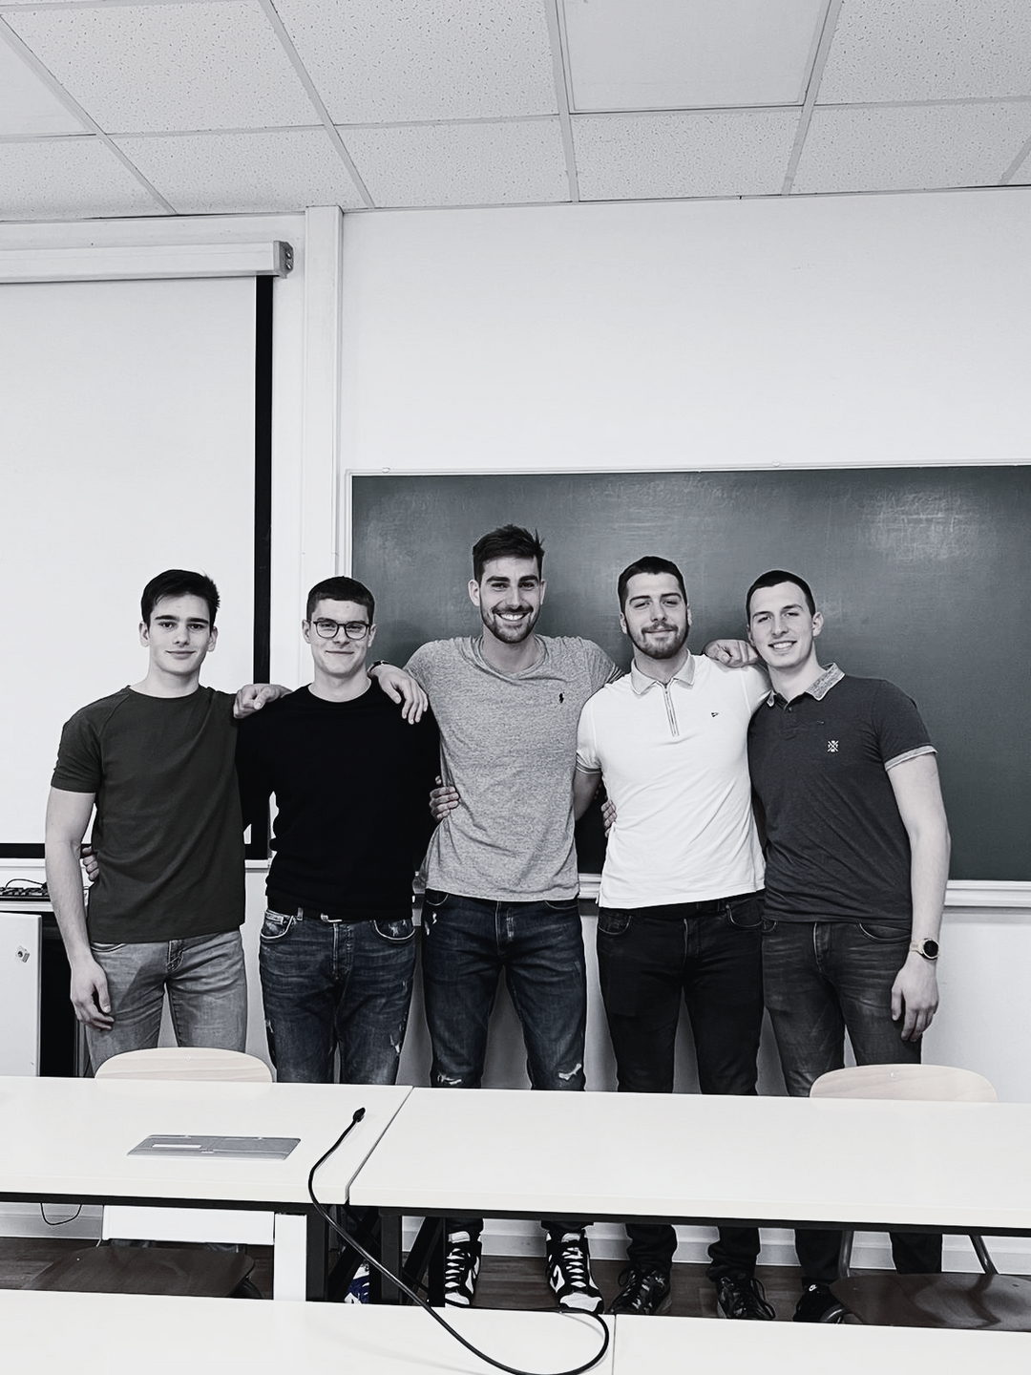
THANK YOU!

